Slide 1

Big Data Infrastructure
Session 8: NoSQL
Jimmy Lin
University of Maryland
Monday, March 30, 2015
This work is licensed under a Creative Commons Attribution-Noncommercial-Share Alike 3.0 United States See http://creativecommons.org/licenses/by-nc-sa/3.0/us/ for details

Slide 2
The Fundamental Problem
We want to keep track of mutable state in a scalable manner
Assumptions:
State organized in terms of many “records”
State unlikely to fit on single machine, must be distributed
MapReduce won’t do!
(note: much of this material belongs in a distributed systems or databases course)

Slide 3
Three Core Ideas
Partitioning (sharding)
For scalability
For latency
Replication
For robustness (availability)
For throughput
Caching
For latency

Slide 4
We got 99 problems…
How do we keep replicas in sync?
How do we synchronize transactions across multiple partitions?
What happens to the cache when the underlying data changes?

Slide 5

Relational Databases
… to the rescue!
Source: images.wikia.com/batman/images/b/b1/Bat_Signal.jpg

Slide 6
What do RDBMSes provide?
Relational model with schemas
Powerful, flexible query language
Transactional semantics: ACID
Rich ecosystem, lots of tool support

Slide 7
How do RDBMSes do it?
Transactions on a single machine: (relatively) easy!
Partition tables to keep transactions on a single machine
Example: partition by user
What about transactions that require multiple machine?
Example: transactions involving multiple users
Solution: Two-Phase Commit

Slide 8
2PC: Sketch
Okay everyone, PREPARE!
YES
Good. COMMIT!
ACK!
YES
DONE!
ACK!
Coordinator
YES
ACK!
subordinates

Slide 9
2PC: Sketch
Okay everyone, PREPARE!
YES
ABORT!
YES
Coordinator
NO
subordinates

Slide 10
2PC: Sketch
Okay everyone, PREPARE!
YES
Good. COMMIT!
ACK!
YES
ROLLBACK!
ACK!
Coordinator
YES
subordinates

Slide 11
2PC: Assumptions and Limitations
Assumptions:
Persistent storage and write-ahead log at every node
WAL is never permanently lost
Limitations:
It’s blocking and slow
What if the coordinator dies?
Solution: Paxos!
(details beyond scope of this course)

Slide 12
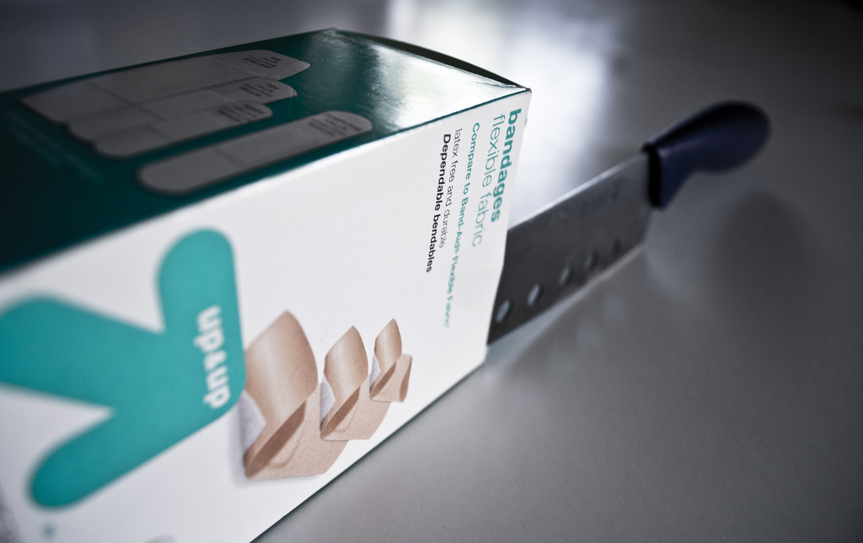
RDBMSes: Pain Points
Source: www.flickr.com/photos/spencerdahl/6075142688/

Slide 13
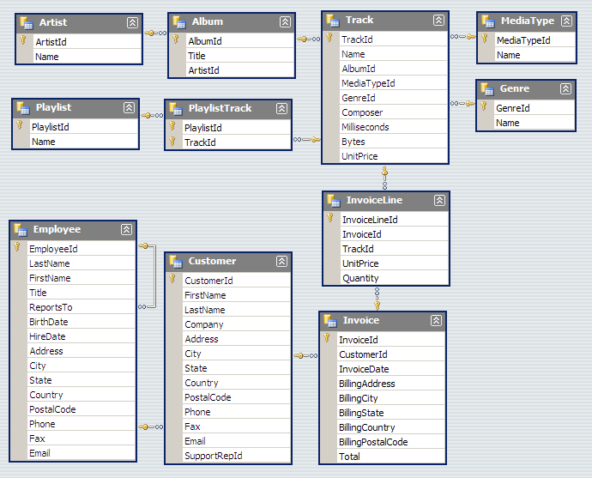
#1: Must design up front, painful to evolve
Note: Flexible design doesn’t mean no design!

Slide 14
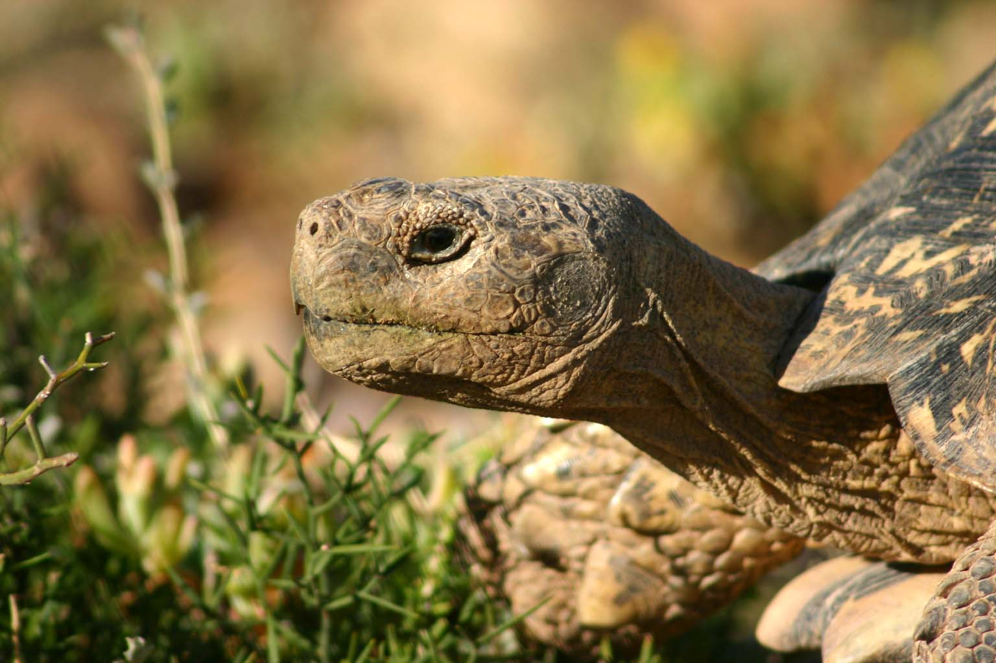
#2: 2PC is slow!
Source: Wikipedia (Tortoise)

Slide 15

#3: Cost!
Source: www.flickr.com/photos/gnusinn/3080378658/

Slide 16
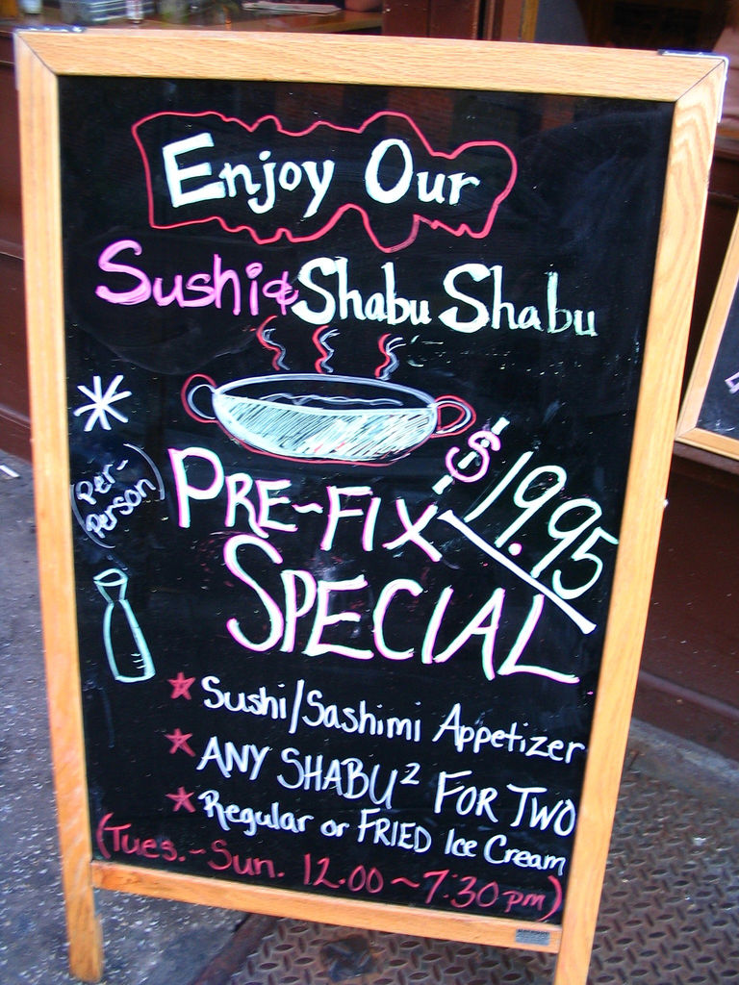
What do RDBMSes provide?
Relational model with schemas
Powerful, flexible query language
Transactional semantics: ACID
Rich ecosystem, lots of tool support
What if we want a la carte?
Source: www.flickr.com/photos/vidiot/18556565/

Slide 17
Features a la carte?
What if I’m willing to give up consistency for scalability?
What if I’m willing to give up the relational model for something more flexible?
What if I just want a cheaper solution?
Enter… NoSQL!

Slide 18
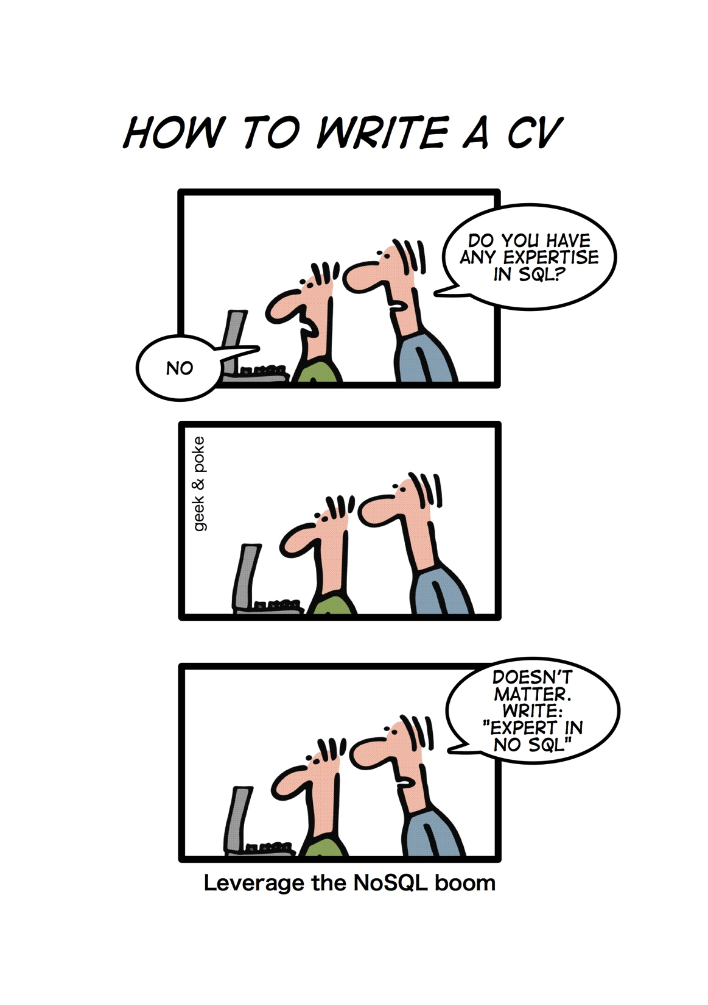
Source: geekandpoke.typepad.com/geekandpoke/2011/01/nosql.html

Slide 19
NoSQL
(Not only SQL)
Horizontally scale “simple operations”
Replicate/distribute data over many servers
Simple call interface
Weaker concurrency model than ACID
Efficient use of distributed indexes and RAM
Flexible schemas
Source: Cattell (2010). Scalable SQL and NoSQL Data Stores. SIGMOD Record.

Slide 20
(Major) Types of NoSQL databases
Key-value stores
Column-oriented databases
Document stores
Graph databases

Slide 21
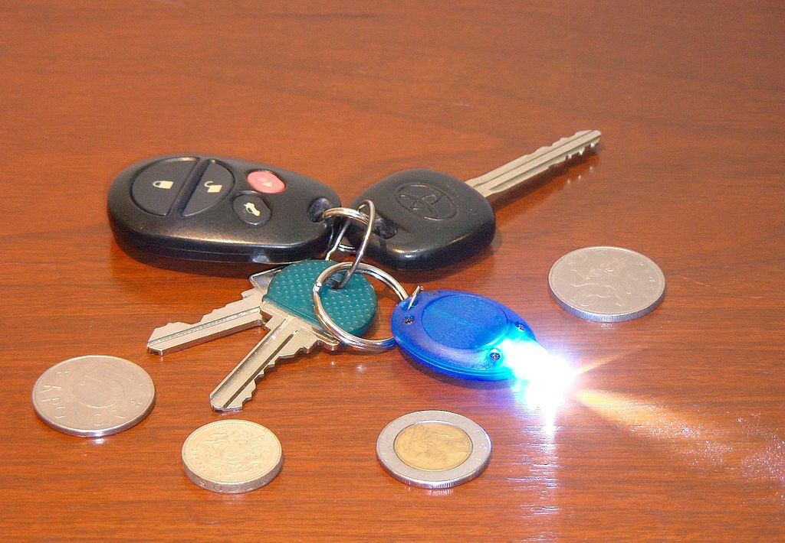
Key-Value Stores
Source: Wikipedia (Keychain)

Slide 22
Key-Value Stores: Data Model
Stores associations between keys and values
Keys are usually primitives
For example, ints, strings, raw bytes, etc.
Values can be primitive or complex: usually opaque to store
Primitives: ints, strings, etc.
Complex: JSON, HTML fragments, etc.

Slide 23
Key-Value Stores: Operations
Very simple API:
Get – fetch value associated with key
Put – set value associated with key
Optional operations:
Multi-get
Multi-put
Range queries
Consistency model:
Atomic puts (usually)
Cross-key operations: who knows?

Slide 24
Key-Value Stores: Implementation
Non-persistent:
Just a big in-memory hash table
Persistent
Wrapper around a traditional RDBMS
What if data doesn’t fit on a single machine?

Slide 25
Simple Solution: Partition!
Partition the key space across multiple machines
Let’s say, hash partitioning
For n machines, store key k at machine h(k) mod n
Okay… But:
How do we know which physical machine to contact?
How do we add a new machine to the cluster?
What happens if a machine fails?
See the problems here?

Slide 26
Clever Solution
Hash the keys
Hash the machines also!
Distributed hash tables!
(following combines ideas from several sources…)

Slide 27

h = 2^{n} – 1
h = 0

Slide 28
h = 2^{n} – 1
h = 0
Each machine holds pointers to predecessor and successor
Send request to any node, gets routed to correct one in O(n) hops
Can we do better?
Routing: Which machine holds the key?

Slide 29
h = 2^{n} – 1
h = 0
Each machine holds pointers to predecessor and successor
+ “finger table” (+2, +4, +8, …)
Send request to any node, gets routed to correct one in O(log n) hops
Routing: Which machine holds the key?

Slide 30
h = 2^{n} – 1
h = 0
Simpler Solution
Service Registry
Routing: Which machine holds the key?

Slide 31
Stoica et al. (2001). Chord: A Scalable Peer-to-peer Lookup Service for Internet Applications. SIGCOMM.
h = 2^{n} – 1
h = 0
Cf. Gossip Protoccols
How do we rebuild the predecessor, successor, finger tables?
New machine joins: What happens?

Slide 32
h = 2^{n} – 1
h = 0
Solution: Replication
N = 3, replicate +1, –1
Covered!
Covered!
Machine fails: What happens?
How to actually replicate? Later…

Slide 33
Another Refinement: Virtual Nodes
Don’t directly hash servers
Create a large number of virtual nodes, map to physical servers
Better load redistribution in event of machine failure
When new server joins, evenly shed load from other servers

Slide 34

Bigtable
Source: Wikipedia (Table)

Slide 35
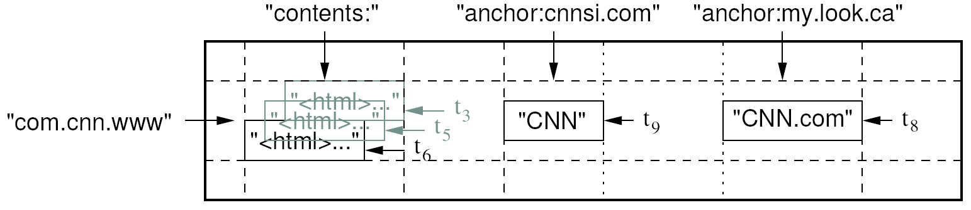
Data Model
A table in Bigtable is a sparse, distributed, persistent multidimensional sorted map
Map indexed by a row key, column key, and a timestamp
(row:string, column:string, time:int64) → uninterpreted byte array
Supports lookups, inserts, deletes
Single row transactions only
Image Source: Chang et al., OSDI 2006

Slide 36
Rows and Columns
Rows maintained in sorted lexicographic order
Applications can exploit this property for efficient row scans
Row ranges dynamically partitioned into tablets
Columns grouped into column families
Column key = family:qualifier
Column families provide locality hints
Unbounded number of columns
At the end of the day, it’s all key-value pairs!

Slide 37
Bigtable Building Blocks
GFS
Chubby
SSTable

Slide 38
SSTable
Basic building block of Bigtable
Persistent, ordered immutable map from keys to values
Stored in GFS
Sequence of blocks on disk plus an index for block lookup
Can be completely mapped into memory
Supported operations:
Look up value associated with key
Iterate key/value pairs within a key range
64K block
64K block
64K block
SSTable
Index
Source: Graphic from slides by Erik Paulson

Slide 39
Tablet
Dynamically partitioned range of rows
Built from multiple SSTables
Tablet
Start:aardvark
End:apple
64K block
64K block
64K block
SSTable
64K block
64K block
64K block
SSTable
Index
Index
Source: Graphic from slides by Erik Paulson

Slide 40
Table
Multiple tablets make up the table
SSTables can be shared
Tablet
Tablet
aardvark
apple
apple_two_E
boat
SSTable
SSTable
SSTable
SSTable
Source: Graphic from slides by Erik Paulson

Slide 41
Architecture
Client library
Single master server
Tablet servers

Slide 42
Bigtable Master
Assigns tablets to tablet servers
Detects addition and expiration of tablet servers
Balances tablet server load
Handles garbage collection
Handles schema changes

Slide 43
Bigtable Tablet Servers
Each tablet server manages a set of tablets
Typically between ten to a thousand tablets
Each 100-200 MB by default
Handles read and write requests to the tablets
Splits tablets that have grown too large

Slide 44
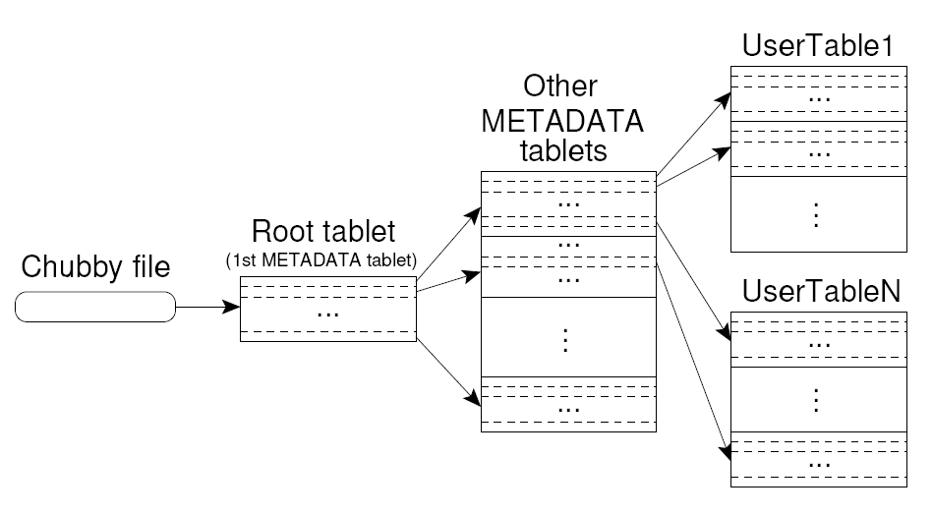
Tablet Location
Upon discovery, clients cache tablet locations
Image Source: Chang et al., OSDI 2006

Slide 45
Tablet Assignment
Master keeps track of:
Set of live tablet servers
Assignment of tablets to tablet servers
Unassigned tablets
Each tablet is assigned to one tablet server at a time
Tablet server maintains an exclusive lock on a file in Chubby
Master monitors tablet servers and handles assignment
Changes to tablet structure
Table creation/deletion (master initiated)
Tablet merging (master initiated)
Tablet splitting (tablet server initiated)

Slide 46
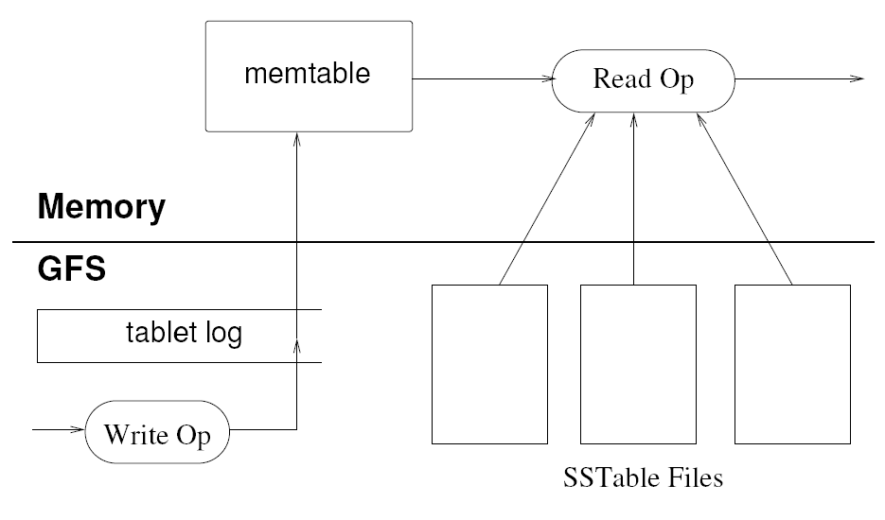
Tablet Serving
“Log Structured Merge Trees”
Image Source: Chang et al., OSDI 2006

Slide 47
Compactions
Minor compaction
Converts the memtable into an SSTable
Reduces memory usage and log traffic on restart
Merging compaction
Reads the contents of a few SSTables and the memtable, and writes out a new SSTable
Reduces number of SSTables
Major compaction
Merging compaction that results in only one SSTable
No deletion records, only live data

Slide 48
Bigtable Applications
Data source and data sink for MapReduce
Google’s web crawl
Google Earth
Google Analytics

Slide 49
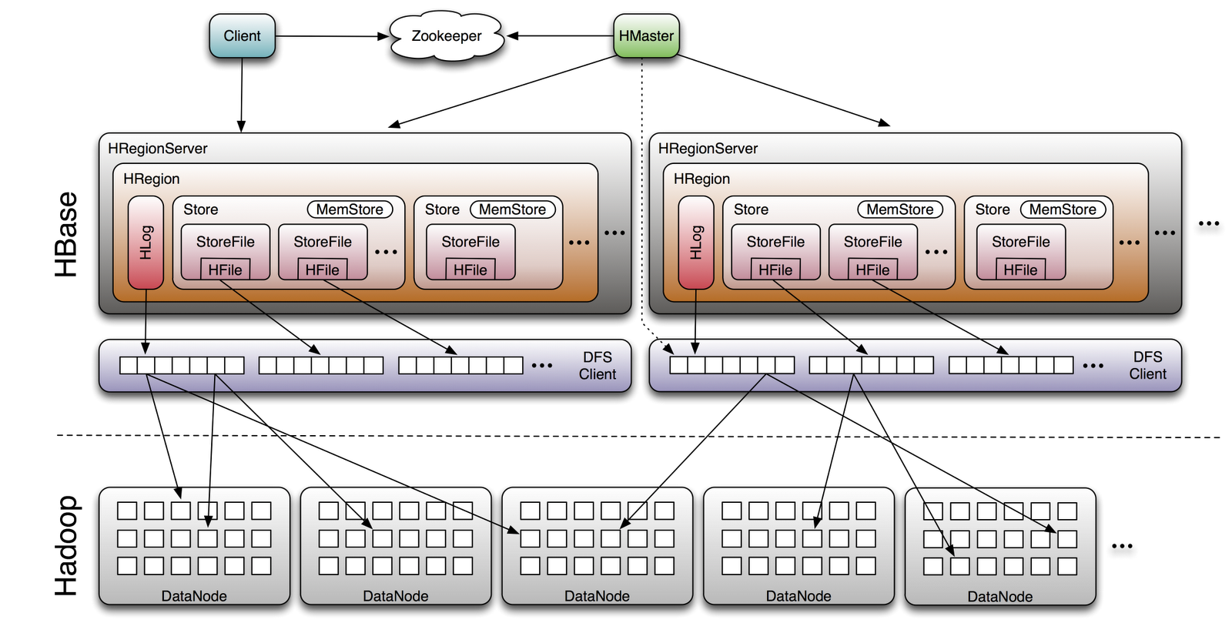
HBase
Image Source: http://www.larsgeorge.com/2009/10/hbase-architecture-101-storage.html

Slide 50
Challenges
Keep it simple!
Keep it flexible!
Push functionality onto application
… and it’s still hard to get right!
Example: splitting and compaction storms

Slide 51
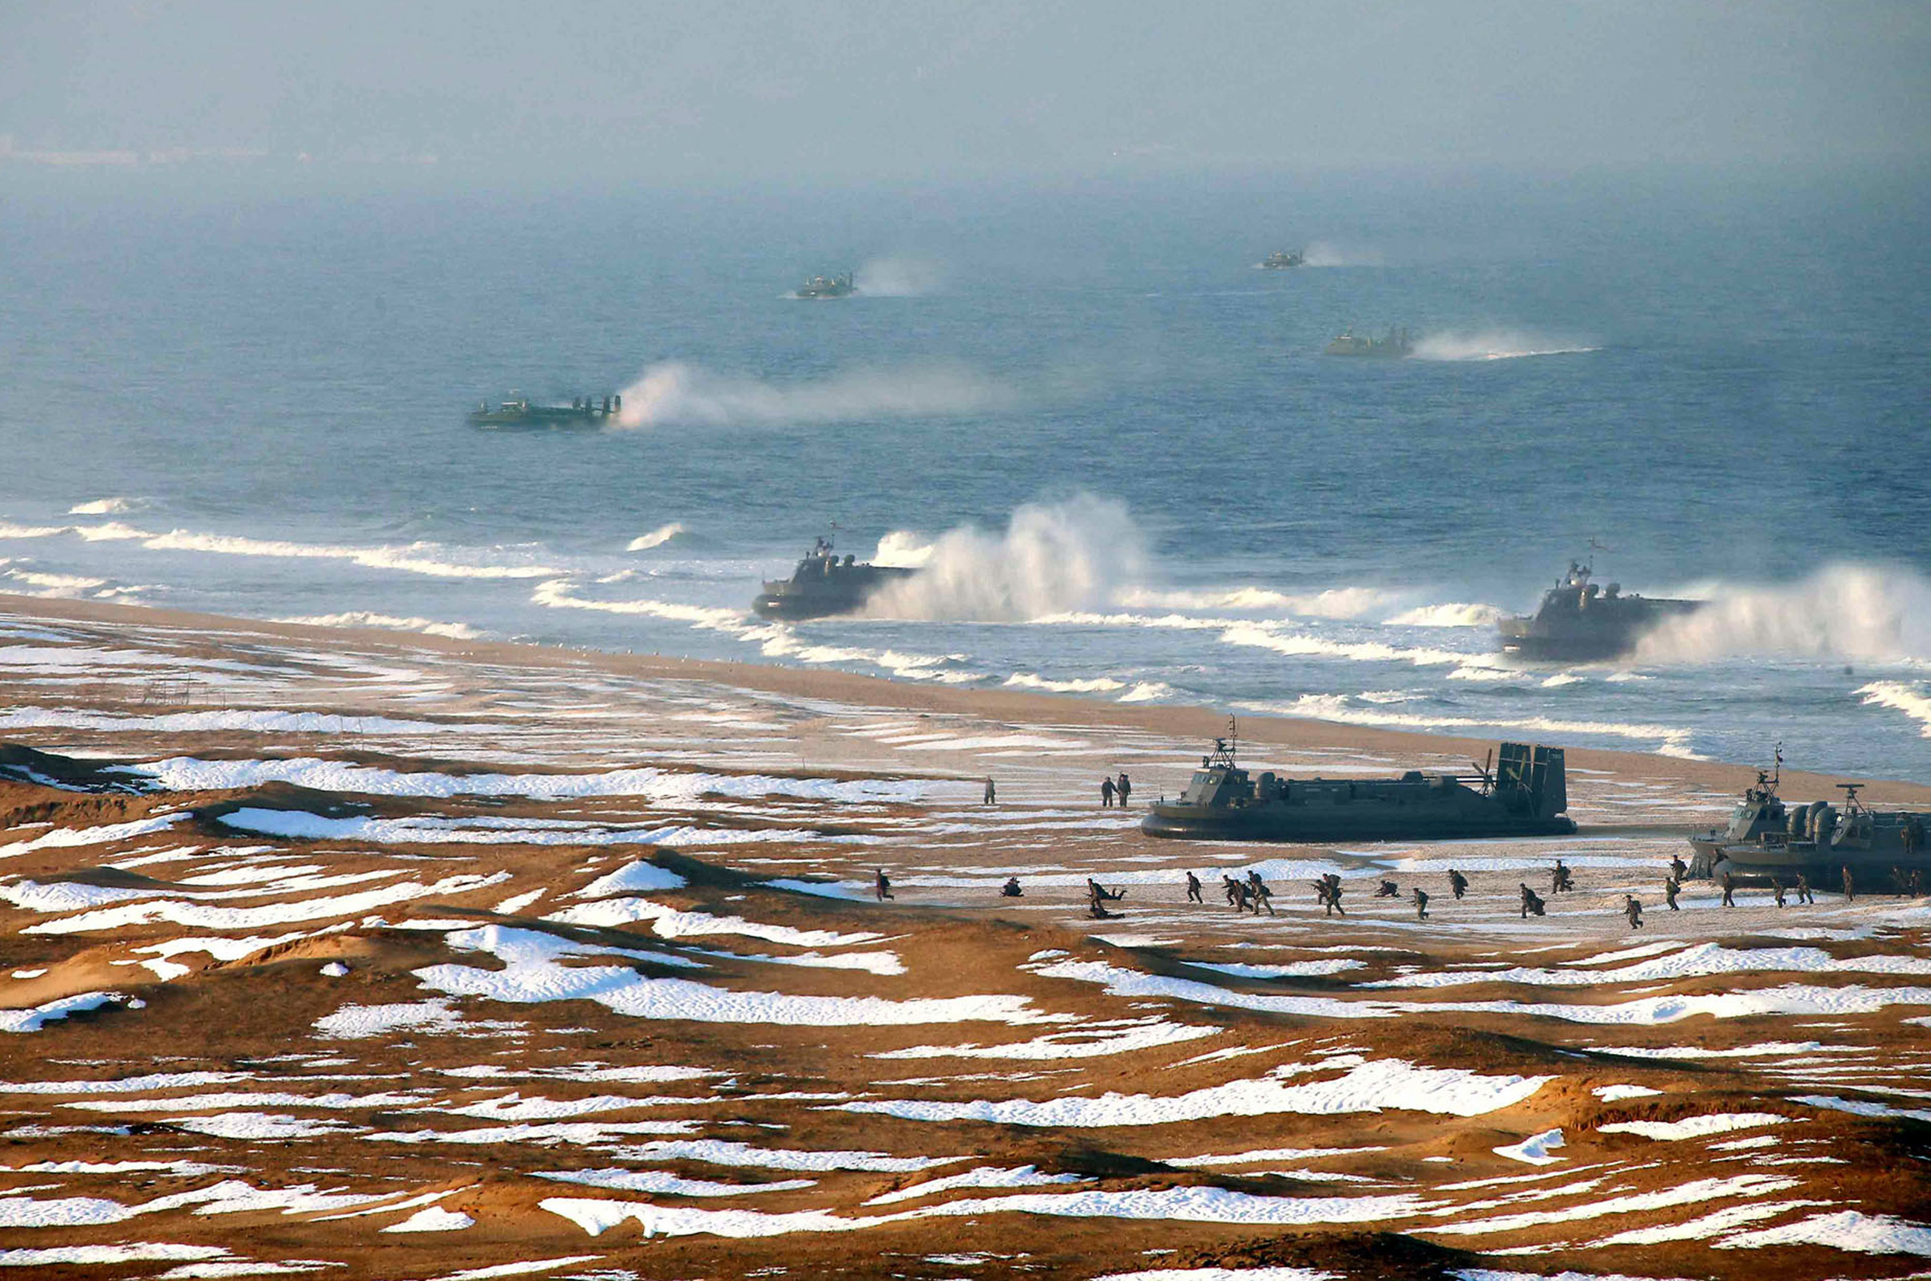
Back to consistency…

Slide 52
Consistency Scenarios
People you don’t want seeing your pictures:
Alice removes mom from list of people who can view photos
Alice posts embarrassing pictures from Spring Break
Can mom see Alice’s photo?
Why am I still getting messages?
Bob unsubscribes from mailing list
Message sent to mailing list right after
Does Bob receive the message?

Slide 53
Three Core Ideas
Partitioning (sharding)
For scalability
For latency
Replication
For robustness (availability)
For throughput
Caching
For latency
Let’s just focus on this

Slide 54
CAP “Theorem”
(Brewer, 2000)
Consistency
Availability
Partition tolerance
… pick two

Slide 55
CAP Tradeoffs
CA = consistency + availability
E.g., parallel databases that use 2PC
AP = availability + tolerance to partitions
E.g., DNS, web caching

Slide 56

Is this helpful?
CAP not really even a “theorem” because vague definitions
More precise formulation came a few years later
Wait a sec, that doesn’t sound right!
Source: Abadi (2012) Consistency Tradeoffs in Modern Distributed Database System Design. IEEE Computer, 45(2):37-42

Slide 57
Abadi Says…
CP makes no sense!
CAP says, in the presence of P, choose A or C
But you’d want to make this tradeoff even when there is no P
Fundamental tradeoff is between consistency and latency
Not available = (very) long latency

Slide 58
Replication possibilities
Update sent to all replicas at the same time
To guarantee consistency you need something like Paxos
Update sent to a master
Replication is synchronous
Replication is asynchronous
Combination of both
Update sent to an arbitrary replica
All these possibilities involve tradeoffs!
“eventual consistency”

Slide 59
Move over, CAP
PACELC (“pass-elk”)
PAC
If there’s a partition, do we choose A or C?
ELC
Otherwise, do we choose latency or consistency?

Slide 60
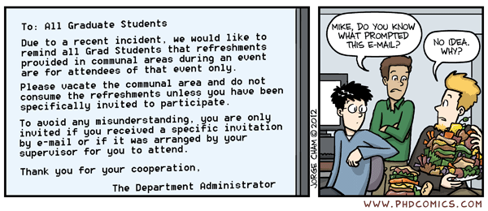
Morale of the story: there’s no free lunch!
Source: www.phdcomics.com/comics/archive.php?comicid=1475

Slide 61
Three Core Ideas
Partitioning (sharding)
For scalability
For latency
Replication
For robustness (availability)
For throughput
Caching
For latency
Quick look at this

Slide 62
“Unit of Consistency”
Single record:
Relatively straightforward
Complex application logic to handle multi-record transactions
Arbitrary transactions:
Requires 2PC/Paxos
Middle ground: entity groups
Groups of entities that share affinity
Co-locate entity groups
Provide transaction support within entity groups
Example: user + user’s photos + user’s posts etc.

Slide 63
Three Core Ideas
Partitioning (sharding)
For scalability
For latency
Replication
For robustness (availability)
For throughput
Caching
For latency
This is really hard!

Slide 64
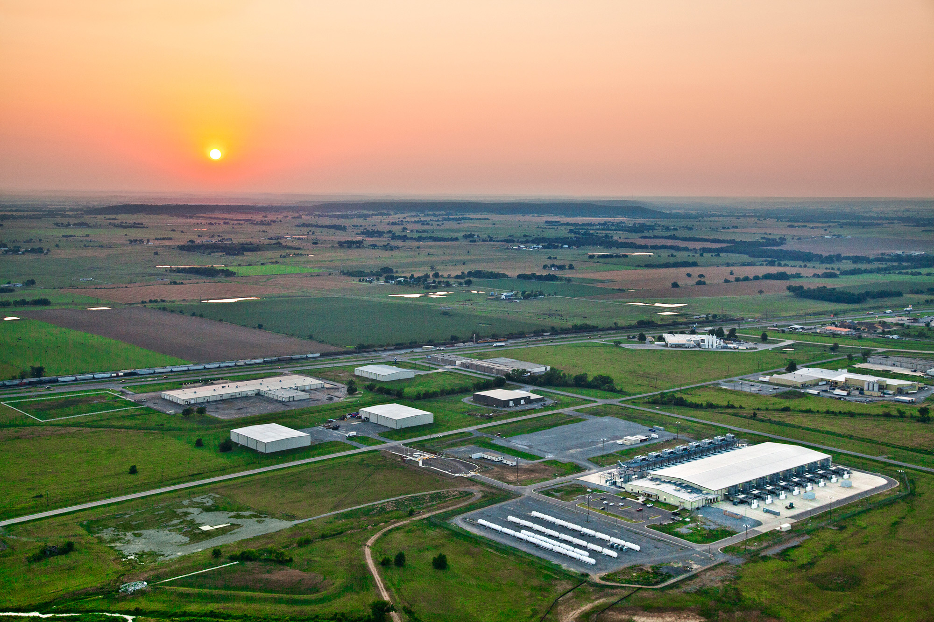
Now imagine multiple datacenters…
What’s different?
Source: Google

Slide 65
Three Core Ideas
Partitioning (sharding)
For scalability
For latency
Replication
For robustness (availability)
For throughput
Caching
For latency
Quick look at this

Slide 66
Facebook Architecture
memcached
MySQL
Read path:
Look in memcached
Look in MySQL
Populate in memcached
Write path:
Write in MySQL
Remove in memcached
Subsequent read:
Look in MySQL
Populate in memcached
✔
Source: www.facebook.com/note.php?note_id=23844338919

Slide 67
Facebook Architecture: Multi-DC
memcached
memcached
MySQL
MySQL
Replication lag
California
Virginia
User updates first name from “Jason” to “Monkey”.
Write “Monkey” in master DB in CA, delete memcached entry in CA and VA.
Someone goes to profile in Virginia, read VA slave DB, get “Jason”.
Update VA memcache with first name as “Jason”.
Replication catches up. “Jason” stuck in memcached until another write!
Source: www.facebook.com/note.php?note_id=23844338919

Slide 68
Facebook Architecture
memcached
memcached
MySQL
MySQL
Replication
= stream of SQL statements
California
Virginia
Solution: Piggyback on replication stream, tweak SQL
REPLACE INTO profile (`first_name`) VALUES ('Monkey’) WHERE `user_id`='jsobel' MEMCACHE_DIRTY 'jsobel:first_name'
Source: www.facebook.com/note.php?note_id=23844338919

Slide 69
Three Core Ideas
Partitioning (sharding)
For scalability
For latency
Replication
For robustness (availability)
For throughput
Caching
For latency
Get’s go back to this again

Slide 70
Yahoo’s PNUTS
Yahoo’s globally distributed/replicated key-value store
Provides per-record timeline consistency
Guarantees that all replicas provide all updates in same order
Different classes of reads:
Read-any: may time travel!
Read-critical(required version): monotonic reads
Read-latest

Slide 71
PNUTS: Implementation Principles
Each record has a single master
Asynchronous replication across datacenters
Allow for synchronous replicate within datacenters
All updates routed to master first, updates applied, then propagated
Protocols for recognizing master failure and load balancing
Tradeoffs:
Different types of reads have different latencies
Availability compromised when master fails and partition failure in protocol for transferring of mastership

Slide 72
Three Core Ideas
Partitioning (sharding)
For scalability
For latency
Replication
For robustness (availability)
For throughput
Caching
For latency
Have our cake and eat it too?

Slide 73
Google’s Spanner
Features:
Full ACID translations across multiple datacenters, across continents!
External consistency: wrt globally-consistent timestamps!
How?
TrueTime: globally synchronized API using GPSes and atomic clocks
Use 2PC but use Paxos to replicate state
Tradeoffs?

Slide 74

Questions?
Source: Wikipedia (Japanese rock garden)

